Slide 1
Arduino Basics
Ардуино осноВИ
Част 7
gevelichkov@gmail.com

Slide 2
Съдържание
LCD1602
Схема на 8-Bit свързване
Схема на 4-Bit свързване
Схема на свързване с 74НС595
Часовник с Термометър
Свързване с I2C контролер

Slide 3
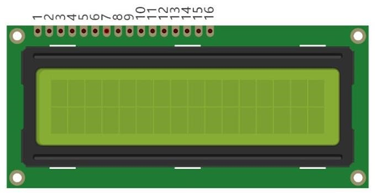
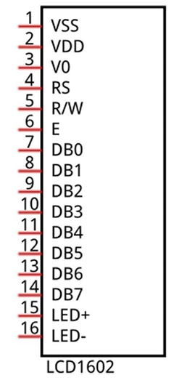
LCD 1602
Pin name | Pin number | Description
VSS | 1 | Negative electrode of power supply
VDD | 2 | Positive electrode of power supply, the voltage is 5V
V0 | 3 | Contrast and adjust the display effect
RS | 4 | Data/Command selection
RW | 5 | Read/Write selection
E | 6 | Enable pin
D0-D7 | 7-14 | Data pin
LED+ | 15 | Positive electrode of backlight LED, the voltage is 5V
LED- | 16 | Negative electrode of backlight LED
16 – брой колони, 2 – брой редове

Slide 4
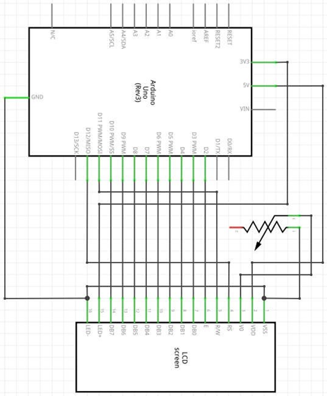
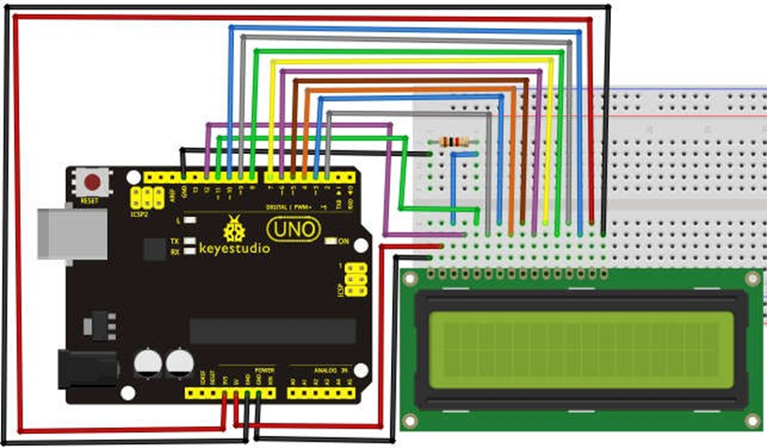
Схема на свързване 8-bit

Slide 5
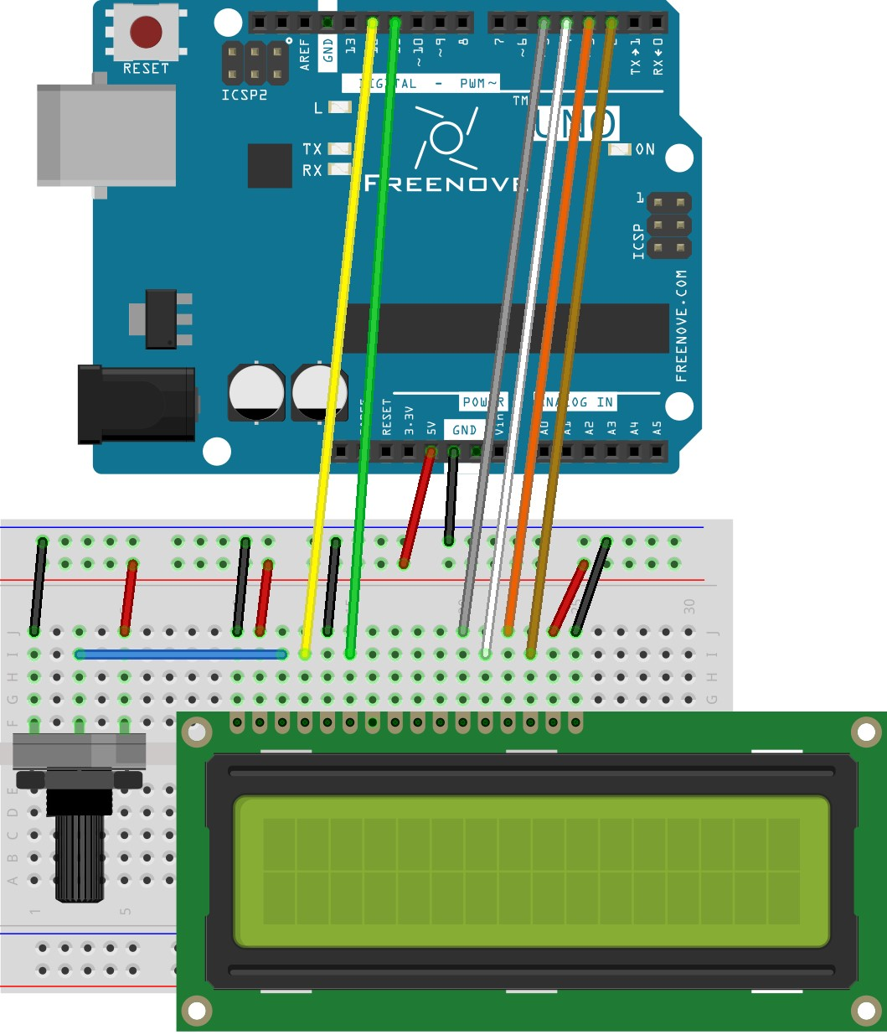
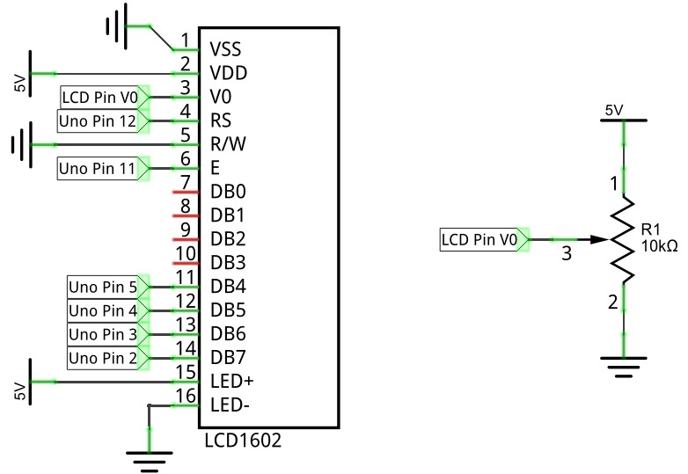
Схема на свързване 4-bit

Slide 6
Код 4-BIT
#include <LiquidCrystal.h>
// initialize the library with the numbers of the interface pins
LiquidCrystal lcd(12, 11, 5, 4, 3, 2);
void setup() {
// set up the LCD's number of columns and rows: lcd.begin(16, 2);
// Print a message to the LCD lcd.print("hello, world!");
} void loop() {
// set the cursor to column 0, line 1
// (note: line 1 is the second row, since counting begins with 0): lcd.setCursor(0, 1);
// print the number of seconds since reset: lcd.print("Counter:"); lcd.print(millis() / 1000);
}

Slide 7
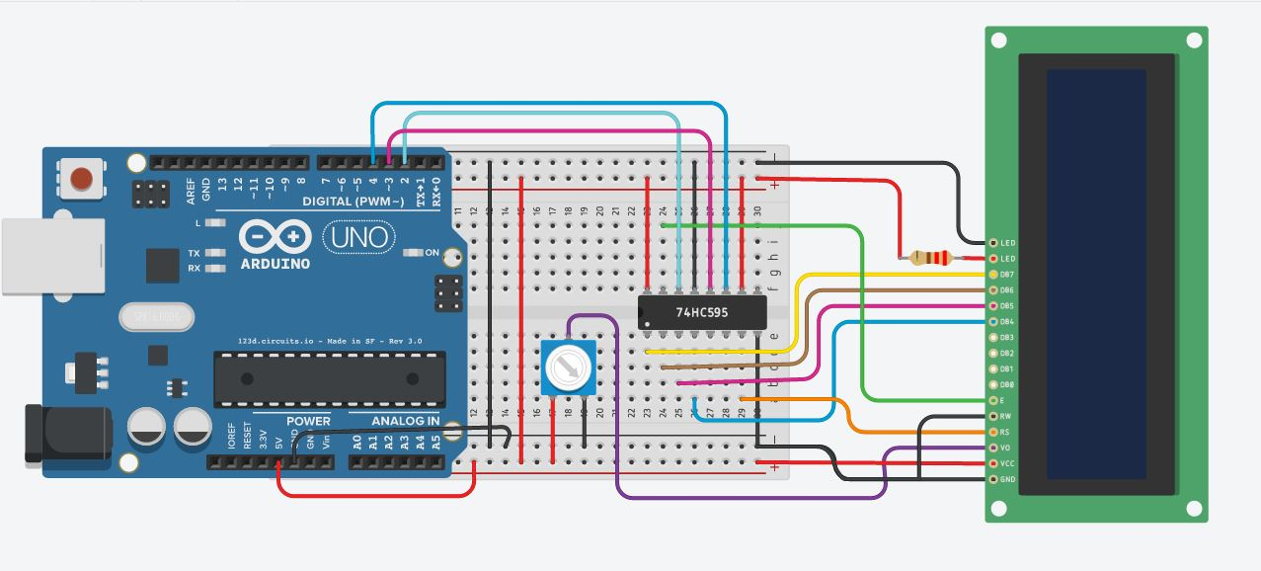
Схема на свързване с 74нс595

Slide 8
КОд с 74НС595
#include
// include the library code:
#include
// initialize the library with the number of the sspin
//(or the latch pin of the 74HC595)
LiquidCrystal lcd(9);
void setup() {
// set up the LCD's number of columns and rows:
lcd.begin(16, 2);
// Print a message to the LCD.
lcd.print("Receipt Machine");
}
void loop() {
// set the cursor to column 0, line 1
// (note: line 1 is the second row, since counting begins with 0):
lcd.setCursor(0, 1);
// print the number of seconds since reset:
lcd.print(millis()/1000);
}

Slide 9

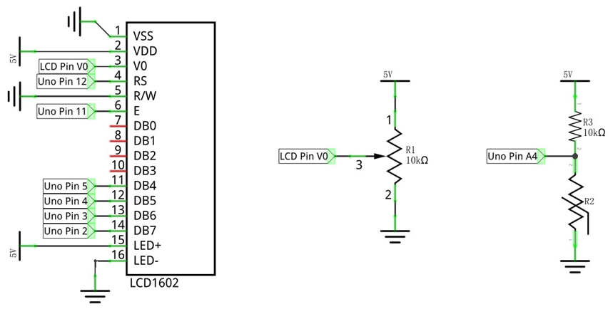
Схема часовник с термометар

Slide 10
#include <LiquidCrystal.h> // Contains LiquidCrystal Library
#include <FlexiTimer2.h> // Contains FlexiTimer2 Library
// initialize the library with the numbers of the interface pins
LiquidCrystal lcd(12, 11, 5, 4, 3, 2);
int tempPin = 4; // define the pin of temperature sensor
float tempVal; // define a variable to store temperature value
int hour, minute, second; // define variables stored record time
void setup() {
lcd.begin(16, 2); // set up the LCD's number of columns and rows
startingAnimation(); // display a dynamic start screen
FlexiTimer2::set(1000, timerInt); // configure the timer and interrupt function
FlexiTimer2::start(); // start timer
Serial.begin(9600); // initialize serial port with baud rate 9600
Serial.println("UNO is ready!"); // print the string "UNO is ready!"
Serial.println("Input hour,minute,second to set time.");
}
void loop() {
// Get temperature
tempVal = getTemp();
if (second >= 60) { // when seconds is equal to 60, minutes plus 1
second = 0;
minute++;
if (minute >= 60) { // when minutes is equal to 60, hours plus 1
minute = 0;
hour++;
if (hour >= 24) { // when hours is equal to 24, hours turn to zero
hour = 0;
}
}
}
lcdDisplay(); // display temperature and time information on LCD
delay(200);
}
void startingAnimation() {
for (int i = 0; i < 16; i++) {
lcd.scrollDisplayRight();
}
lcd.print("starting...");
for (int i = 0; i < 16; i++) {
lcd.scrollDisplayLeft();
delay(300);
}
lcd.clear();
}
// the timer interrupt function of FlexiTimer2 is executed every 1s
void timerInt() {
second++; // second plus 1
}
// serial port interrupt function
void serialEvent() {
int inInt[3]; // define an array to save the received serial data
while (Serial.available()) {
for (int i = 0; i < 3; i++) {
inInt[i] = Serial.parseInt(); // receive 3 integer data
}
// print the received data for confirmation
Serial.print("Your input is: ");
Serial.print(inInt[0]);
Serial.print(", ");
Serial.print(inInt[1]);
Serial.print(", ");
Serial.println(inInt[2]);
// use received data to adjust time
hour = inInt[0];
minute = inInt[1];
second = inInt[2];
// print the modified time
Serial.print("Time now is: ");
Serial.print(hour / 10);
Serial.print(hour % 10);
Serial.print(':');
Serial.print(minute / 10);
Serial.print(minute % 10);
Serial.print(':');
Serial.print(second / 10);
Serial.println(second % 10);
}
}
// function used by LCD1602 to display time and temperature
void lcdDisplay() {
lcd.setCursor(0, 0); // set the cursor to (0,0) (first column,first row).
lcd.print("TEMP: "); // display temperature information
lcd.print(tempVal);
lcd.print("C");
lcd.setCursor(0, 1); // set the cursor to (0,1) (first column,second row)
lcd.print("TIME: "); // display time information
lcd.print(hour / 10);
lcd.print(hour % 10);
lcd.print(':');
lcd.print(minute / 10);
lcd.print(minute % 10);
lcd.print(':');
lcd.print(second / 10);
lcd.print(second % 10);
}
// function used to get temperature
float getTemp() {
// Convert analog value of tempPin into digital value
int adcVal = analogRead(tempPin);
// Calculate voltage
float v = adcVal * 5.0 / 1024;
// Calculate resistance value of thermistor
float Rt = 10 * v / (5 - v);
// Calculate temperature (Kelvin)
float tempK = 1 / (log(Rt / 10) / 3950 + 1 / (273.15 + 25));
// Calculate temperature (Celsius)
return tempK - 273.15;
}

Slide 11
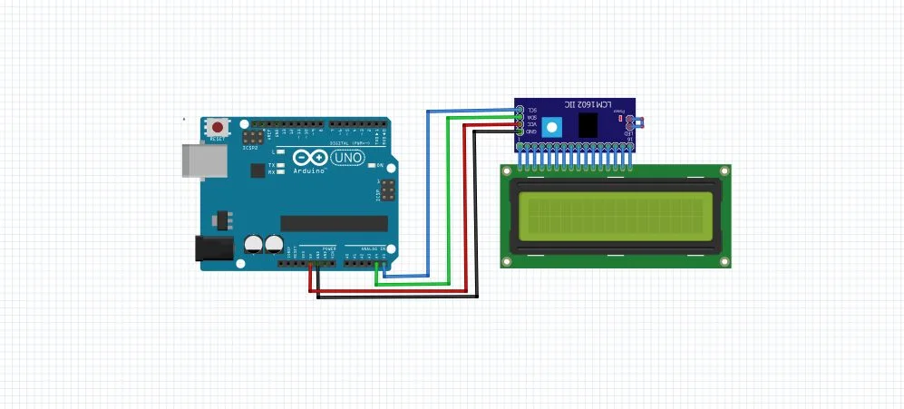
Схема на свързване I2C Bus
https://www.instructables.com/id/How-to-Connect-I2C-Lcd-Display-to-Arduino-Uno/

Slide 12
Полезни Линкове
https://gustmees.wordpress.com/2018/08/05/first-steps-with-the-arduino-uno-r3-and-nano-maker-makered-coding-rfid-rc522-tag-card-reader-with-lcd1602-i2c/
https://receiptmachine.wordpress.com/2013/01/22/arduino-lcd-display/

Slide 13
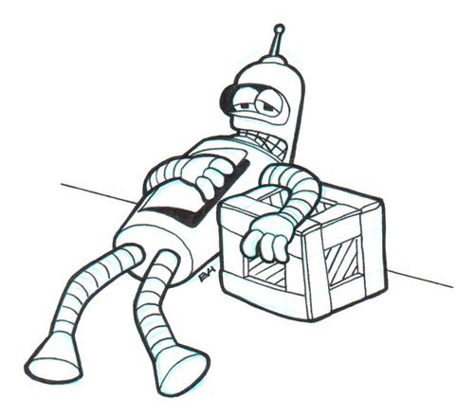
Поздравления ! ! ! вече сте шест крачкИ напред ;)

Slide 14
ПРавила за безопасност ! ! !

